Slide 1
What is matplotlib.pyplot
pyplot is a module in the matplotlib package.
matplotlib.pyplot is a collection of command style functions that make matplotlib work like MATLAB.
Each pyplot function makes some change to a figure: e.g., creates a figure, creates a plotting area in a figure, decorates the plot with labels, plots some lines in a plotting area, etc.
In matplotlib.pyplot various states are preserved across function calls, so that it keeps track of things like the current figure and plotting area.
#Importing pyplot
from matplotlib import pyplot as plt
#Plotting to our canvas
plt.plot([1,2,3],[4,5,1])
plt.title(‘First Example')
plt.ylabel('Y axis')
plt.xlabel('X axis')
#Showing what we plotted
plt.show()

Slide 2
Figure and Axes
The Figure is the overall window or page that everything is drawn on.
It’s the top-level component of all the ones that you will consider.
You can create multiple independent Figures.
A Figure can have several other things in it, such as a suptitle, legend and color bar to your Figure.
To the figure you add Axes.
The Axes is the area on which the data is plotted with functions such as plot() and scatter() and that can have ticks, labels, etc. associated with it.
This explains why Figures can contain multiple Axes.

Slide 3
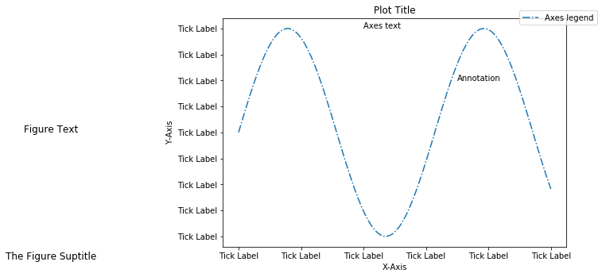
The anatomy of a matplotlib plot

Slide 4
plot() is a versatile command, and will take an arbitrary number of arguments.
For example, to plot x versus y, you can issue the command:
plt.plot([1, 2, 3, 4], [1, 4, 9, 16])
For every x, y pair of arguments, there is an optional third argument which is the format string that indicates the color and line type of the plot.
The letters and symbols of the format string are from MATLAB, and you concatenate a color string with a line style string.
The default format string is ‘b-‘, which is a solid blue line. For example, to plot the above with red circles, you would issue
import matplotlib.pyplot as plt
plt.plot([1,2,3,4], [1,4,9,16], 'b-')
plt.plot([1,2,3,4], [1,5,8,15], 'ro')
plt.axis([0, 6, 0, 20])
plt.show()

Slide 5
The following script plots the equation y = 2x + 5
import numpy as np
from matplotlib import pyplot as plt
x = np.arange(1,11)
y = 2 * x + 5
plt.title("Matplotlib demo")
plt.xlabel("x axis caption")
plt.ylabel("y axis caption")
plt.plot(x,y)
plt.show()

Slide 6
Syntax for plot function: plot([x], y, [fmt], [x2], y2, [fmt2], ..., **kwargs)
Example with more parameters:
import matplotlib.pyplot as plt
x1,y1=[1,2,3,4], [1,4,9,16]
x2,y2=[1,3,4,6],[1,4,9,16]
x3,y3=[3,1,6,5],[2,1,7,8]
plt.plot(x1,y1,'b-', x2,y2, 'go‘,x3,y3,’.-r’)
plt.axis([0, 7, 0, 20])
plt.xlabel("x axis ")
plt.ylabel("y axis ")
plt.text(2,2,'Text',fontsize='large', color='r')
plt.title('Title')
plt.grid(b=True)
plt.suptitle('Sup Title')
plt.show()

Slide 7
Syntax for Adding Text, Grid Lines
Add text to the axes
matplotlib.pyplot.text(x, y, s, fontdict=None, withdash=<deprecated parameter>, **kwargs)
Add the text s to the axes at location x, y in data coordinates.
Configure the grid lines.
matplotlib.pyplot.grid(b=None, which='major', axis='both', **kwargs)
b : bool or None, optional
Whether to show the grid lines. If any kwargs are supplied, it is assumed you want the grid on and b will be set to True.
which : {'major', 'minor', 'both'}, optional
The grid lines to apply the changes on.
axis : {'both', 'x', 'y'}, optional
The axis to apply the changes on.

Slide 8
Sine Wave Plot
The following script produces the sine wave plot using matplotlib.
import numpy as np
import matplotlib.pyplot as plt
# Compute the x and y coordinates for points on a sine curve
x = np.arange(0, 3 * np.pi, 0.1)
y = np.sin(x)
plt.title("sine wave form")
# Plot the points using matplotlib
plt.plot(x, y)
plt.show()

Slide 9
bar() Graphs
The pyplot submodule provides bar() function to generate bar graphs.
The following example produces the bar graph of two sets of x and y arrays.
x = [5,8,10] ; y = [12,16,6]
x2 = [6,9,11] ;y2 = [6,15,7]
plt.bar(x, y)
plt.bar(x2, y2, color = 'g')
plt.title('Bar graph')
plt.ylabel('Y axis')
plt.xlabel('X axis')
plt.show()

Slide 10
Matplotlib Histogram and numpy.histogram()
Plotting Histogram using Matplotlib
a = np.array([22,87,5,43,56,73,55,54,11,20,51,5,79,31,27])
plt.hist(a, bins = [0,20,40,60,80,100])
plt.title("histogram")
plt.show()
Numpy has a numpy.histogram() function that is a representation of the frequency distribution of data.
Rectangles of equal horizontal size corresponding to class interval called bin and variable height corresponding to frequency.
The numpy.histogram() function takes the input array and bins as two parameters.
The successive elements in bin array act as the boundary of each bin.
hist,bins = np.histogram(a,bins = [0,20,40,60,80,100])
print (hist )
print (bins)

Slide 11
 | Scatterplot
Also known as a Scatter Graph, Point Graph, X-Y Plot, Scatter Chart or Scattergram.
Scatterplots use a collection of points placed using Cartesian Coordinates to display values from two variables.
By displaying a variable in each axis, you can detect if a relationship or correlation between the two variables exists.
Scatter plot requires numeric columns for the x and y axes. These can be specified by the x and y keywords.
Various types of correlation can be interpreted through the patterns displayed on Scatterplots.
These are: positive (values increase together), negative (one value decreases as the other increases), null (no correlation), linear, exponential and U-shaped.
The strength of the correlation can be determined by how closely packed the points are to each other on the graph.
Points that end up far outside the general cluster of points are known as outliers.
Lines or curves are fitted within the graph to aid in analysis and are drawn as close to all the points as possible
This is typically known as the Line of Best Fit or a Trend Line and can be used to make estimates via interpolation.
However, correlation is not causation and another unnoticed variable may be influencing results.

Slide 12
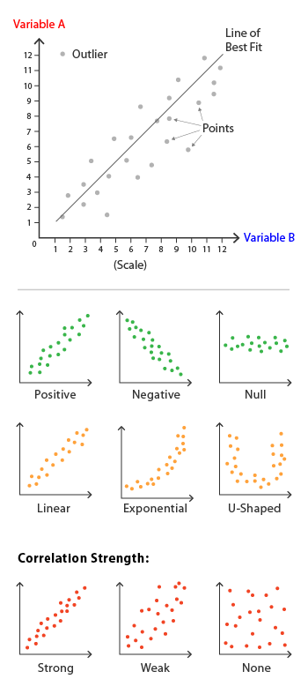

Slide 13
Scatter Plot Using matplotlib
import matplotlib.pyplot as plt
plt.plot([1, 2, 3, 4], [10, 20, 25, 30], color='lightblue', linewidth=3)
plt.scatter([0.3, 3.8, 1.2, 2.5], [11, 25, 9, 26], color='darkgreen', marker='^')
#plt.xlim(0.5, 4.5)
plt.show()

Slide 14
Seed in random number generator
The seed method is used to initialize the pseudorandom number generator in Python.
The random module uses the seed value as a base to generate a random number.
if seed value is not present it takes system current time.
if you provide same seed value before generating random data it will produce the same data.
from random import random,seed
for i in range(2):
print(random())
seed(0)
for i in range(2):
print(random())
seed(10)
for i in range(2):
print(random())
seed(0)
for i in range(2):
print(random())

Slide 15
Scatter Plot Example
from random import random, seed
seed(0)
x = [ int(10*random()) for i in range(15) ]; y = [ int(10*random()) for i in range(15) ]
print(x,y)
plt.scatter(x, y, color='darkgreen', marker='^')
plt.show()
x=range(0,15) ; y=[2*i+int(10*random()) for i in x ]
plt.scatter(x, y, color='darkgreen', marker='^')
plt.show()
x=range(0,15) ; y=[30-2*i+int(10*random()) for i in x ]
plt.scatter(x, y, color='darkgreen', marker='^')
plt.show()

